Slide 1
Variational Dropout Sparsification for Particle Identification speed-up

Slide 2
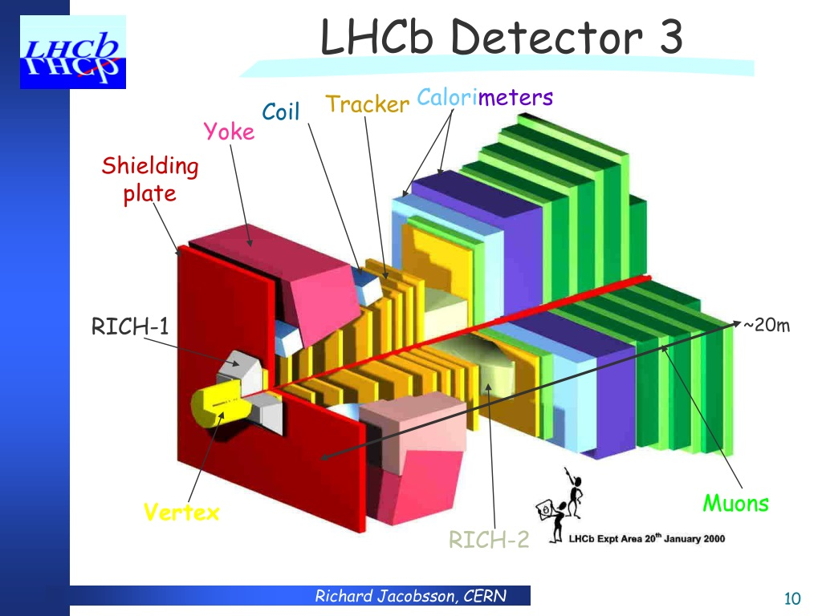
Particles to identify
electron
muon
pion
kaon
proton
ghost type

Slide 3
Grid search
Produces models with good balance between complexity and quality
Requires much time to train
Does not produce the global best model
Required many train-test-evaluate runs instead of one

Slide 4
Pruning
Reduce number of parameters after training → Train only once
Quantization - change floating point types to lower precision
Trained ternary quantization - replace individual weights with one of 3 values: Wn, 0, Wp

Slide 5
Variational Dropout
Dropout - drop random neurons during training to avoid overfitting
Problem: hyperparameter p, no automatic relevance determination
Solution:
Train dropout rate p for all parameters
Drop ones close to 0

Slide 6
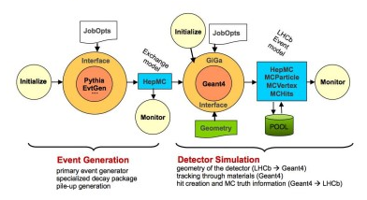
Data
Originally:
6 million samples (1 million for each particle)
Divided for train/test by 50/50
Our case:
60,000 samples (approx 10000 for each particle)
Divided in train/test by 65/35

Slide 7
Results
Method | Neurons | Electron | Ghost | Kaon | Muon | Pion | Proton | Speed-up
6xDNN | 45-48 | 0.9855 | 0.9485 | 0.9148 | 0.9844 | 0.9346 | 0.9178 | x1
1xDNN | 150 | 0.9863 | 0.9570 | 0.9145 | 0.9889 | 0.9463 | 0.9167 | x1
Grid Search | 30 | 0.9871 | 0.9557 | 0.9158 | 0.9883 | 0.9427 | 0.9125 | x5
Pruning | Auto | 0.9843 | 0.9435 | 0.9154 | 0.9834 | 0.9352 | 0.9110 | x5
VarDropout | Auto | 0.9881 | 0.9548 | 0.9244 | 0.9896 | 0.9509 | 0.9228 | x16
Method | Neurons | Electron | Ghost | Kaon | Muon | Pion | Proton | Speed-up
6xDNN | 35 | 0.9236 | 0.8608 | 0.7604 | 0.9337 | 0.8486 | 0.7438 | x1
1xDNN | 140 | 0.9221 | 0.8610 | 0.7691 | 0.9362 | 0.8513 | 0.7349 | x2
Pruning
VarDropout | auto | 0.4968 | 0.5037 | 0.5 | 0.5002 | 0.5 | 0.5 | x0.5

